Slide 1
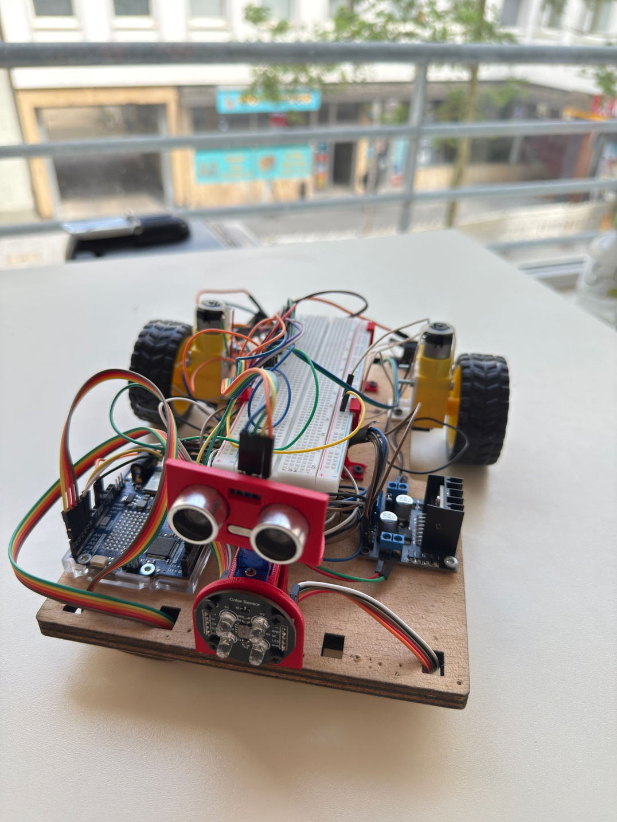



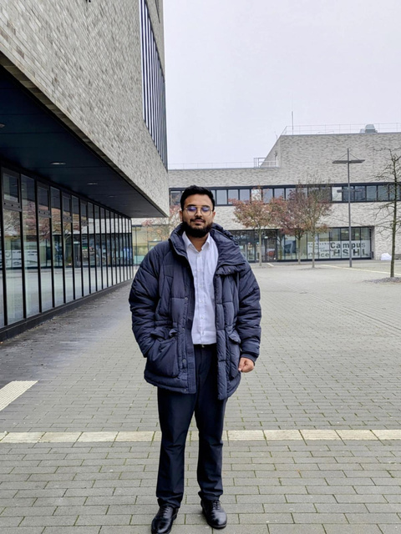

AUTONOMOUS ROBOT CAR
PRESENTED BY: TEAM D4
Md Zulkar Nain Sayed
Md Helal Uddin
Md Arman Zaid Efty

Slide 2

SYSTEM OVERVIEW
Sensor Suite: IR (KY-033), ultrasonic (HC-SR04), and color (TCS3200) sensors enable real-time environment awareness.
2. Adaptive Navigation: Follows line path and dynamically avoids obstacles using
ultrasonic Seosor.
3. Control Core: Arduino Uno R4 WiFi handles sensor data and executes movement logic.
4. Motor Interface: SBC-MotoDriver2 allows precise, bidirectional control of motors.
5. Color-Based Action: Detects object color — avoids red, pushes blue, then resumes line
following
1

Slide 3
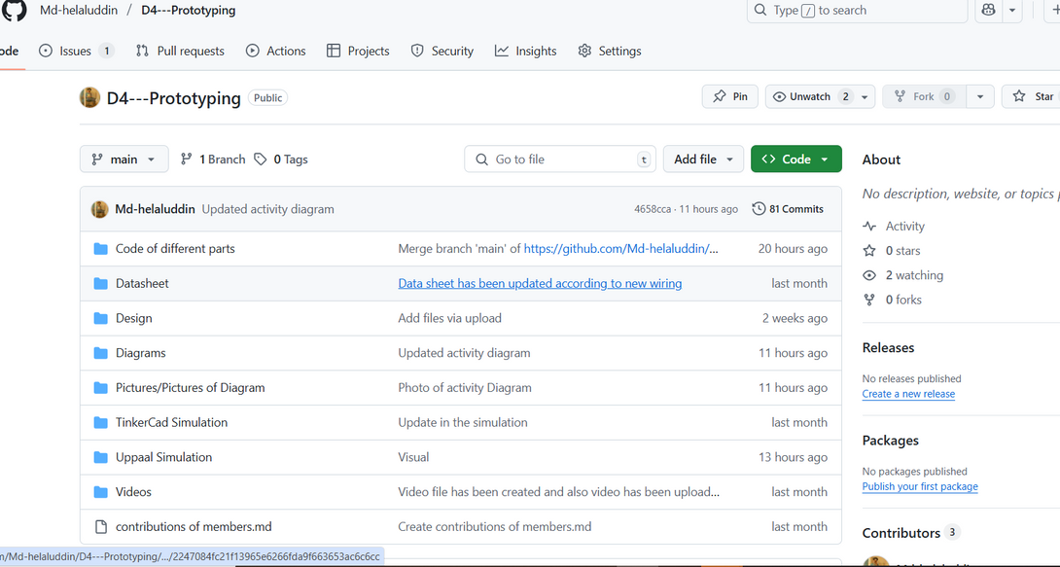
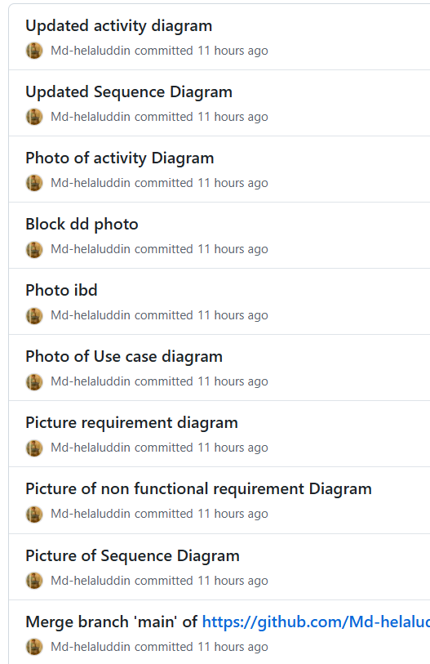
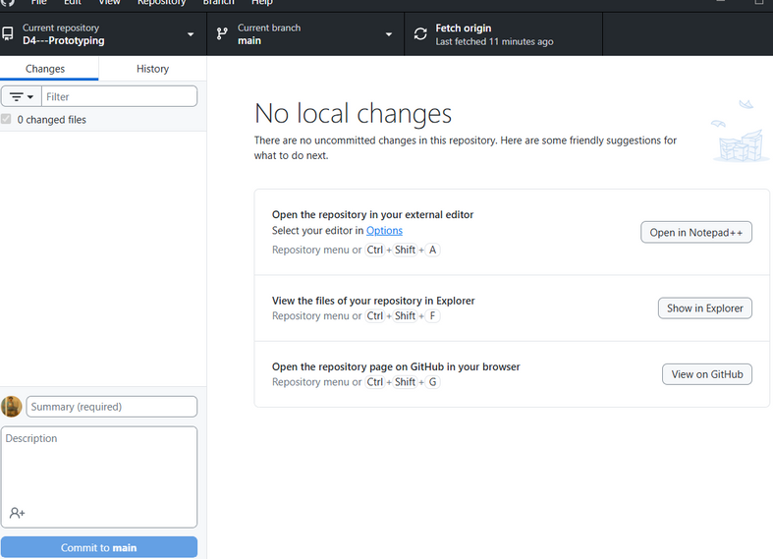
USAGE OF GITHUB
PROFESSIONALLY :
2

Slide 4
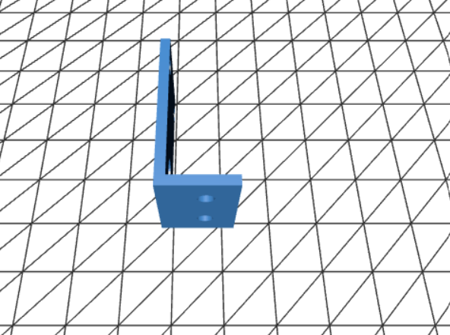
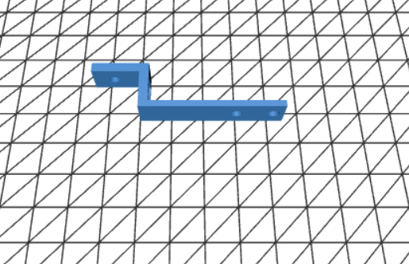
3D DESIGN OF IR AND MOTOR HOLDER:
• Designed custom 3D models for the IR sensor mount and motor holder using SolidWorks
• Ensured precise fitting and stability by aligning dimensions with actual hardware components
IR Holder
Motor Holder
3

Slide 5
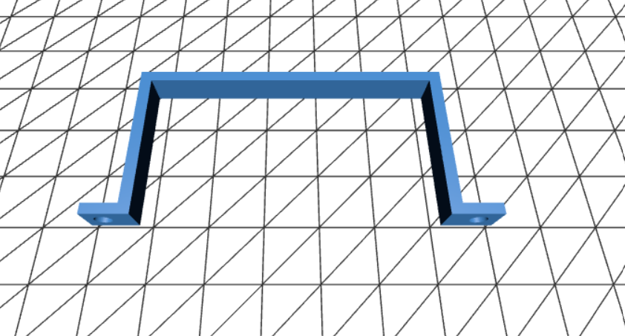
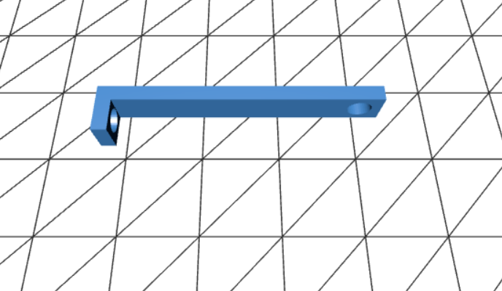
3D DESIGN OF ADDITIONAL COMPONENT AND BREADBOARD HOLDER:
• Created 3D models for a breadboard-battery holder and an additional support bracket for firm motor mounting
• Improved overall hardware stability and wiring management through custom SolidWorks designs
Additional Motor Holder
Bread Board and Battery Holder
4

Slide 6
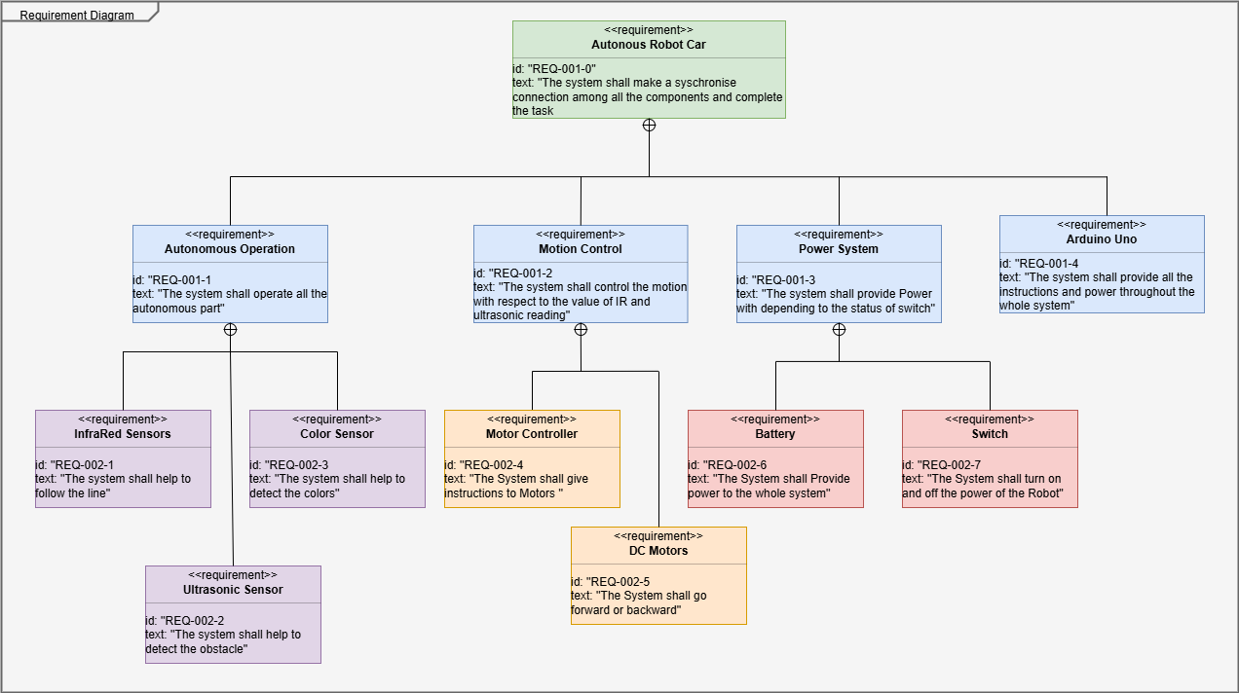
REQUIREMENT DIAGRAM(FUNCTIONAL):
• This diagram has been used to define and organize the system requirements for line following and obstacle avoidance, ensuring all functional goals are clearly specified and traceable.
5

Slide 7
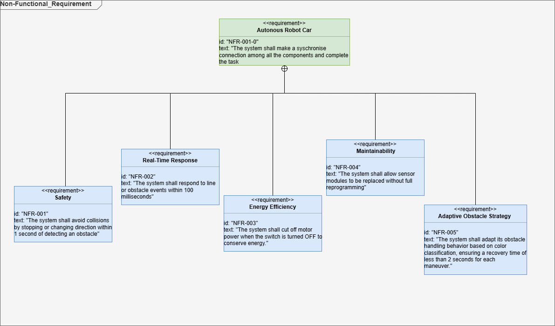
REQUIREMENT DIAGRAM(NON-FUNCTIONAL):
• This diagram has been used to capture non-functional requirements such as performance, reliability, and usability, ensuring the system meets quality expectations.
6

Slide 8
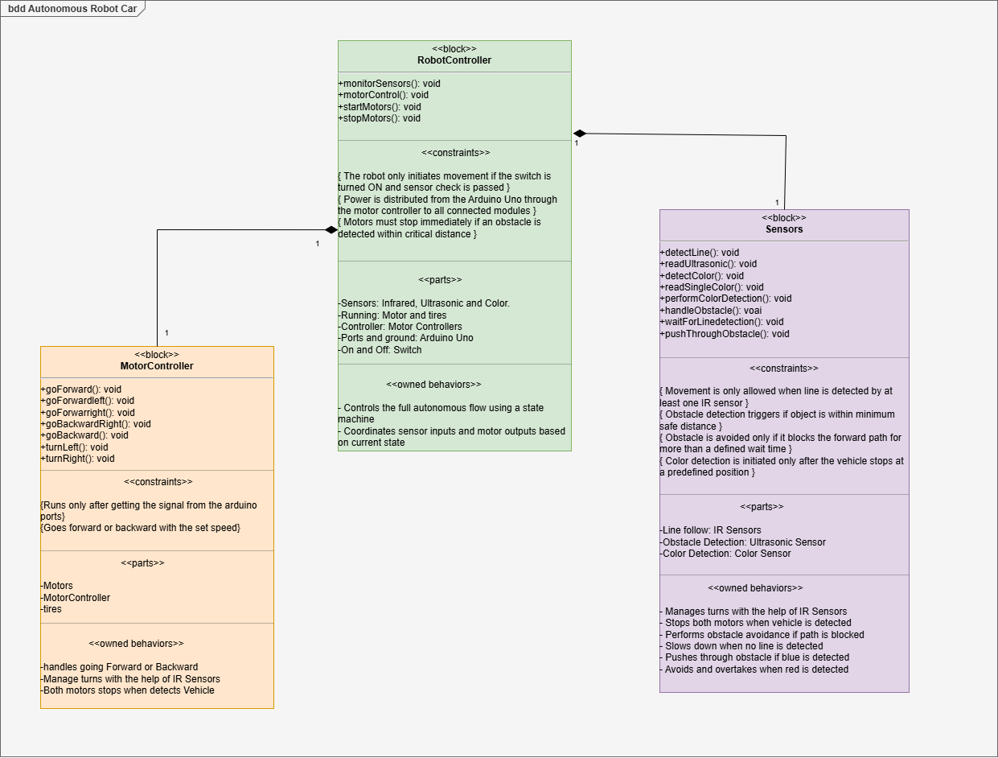
STRUCTURAL DIAGRAM: BLOCK DEFINITION
• This diagram has been used to represent the structural layout of the robot system, including sensors, controller, motor driver, and actuators, along with their relationships.
7

Slide 9
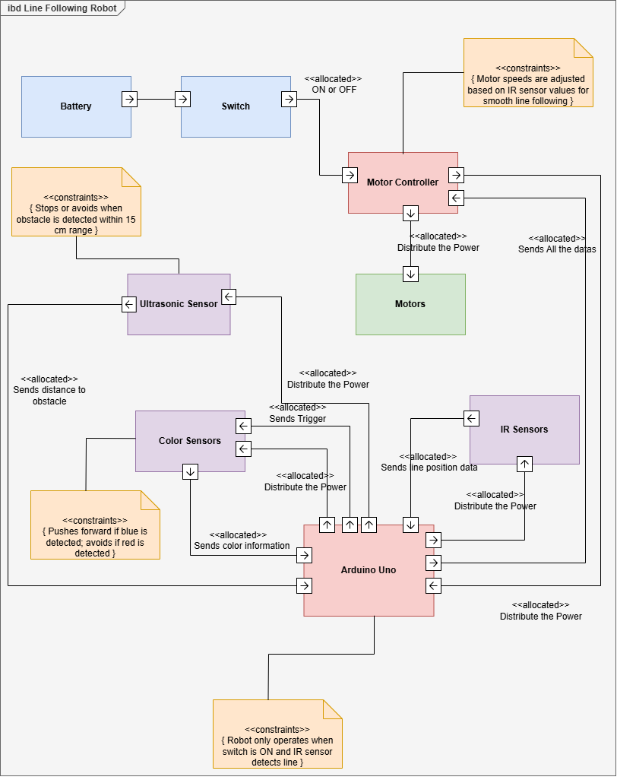
STRUCTURAL DIAGRAM: INTERNAL BLOCK
• Shows internal component interactions
• Includes arduino, sensors, controller, motor driver
• Covers line following, color detection, and obstacle avoidance
8

Slide 10
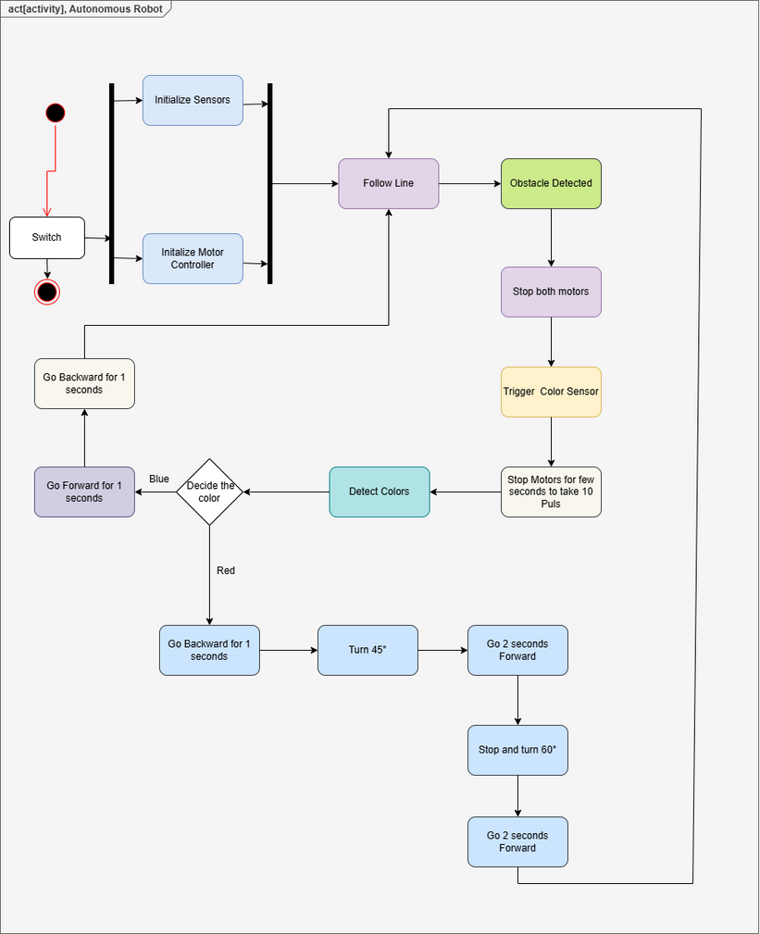
BEHAVIOURAL DIAGRAM: ACTIVITY
• Represents robot’s action flow
• Includes line following, obstacle avoidance
• Adds color-based object response
9

Slide 11
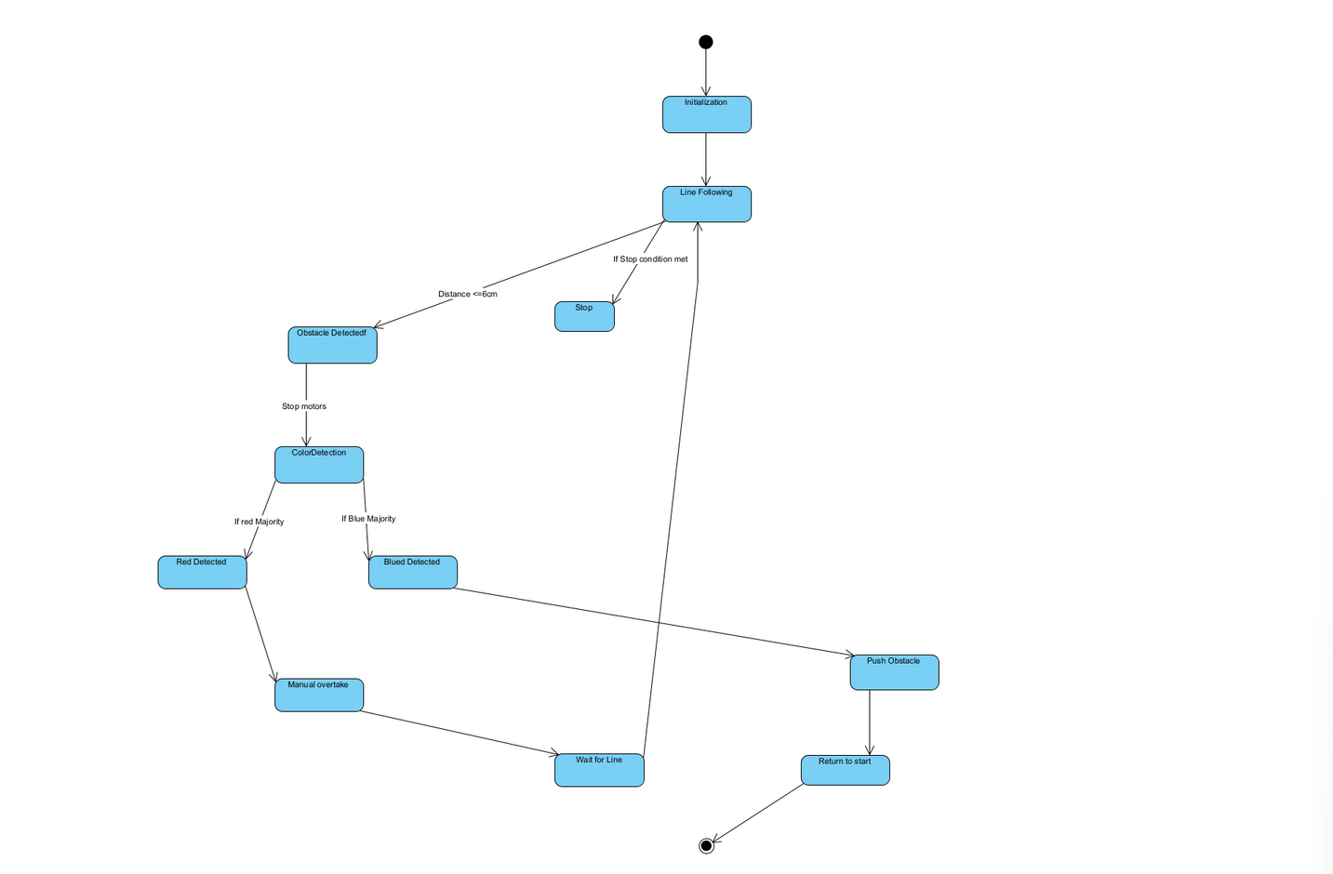
BEHAVIOURAL DIAGRAM:
STATE MACHINE
• Represents different operating states of the robot
• Includes line following, obstacle handling, and color response states
• Shows how the system transitions between behaviors based on sensor input
10

Slide 12
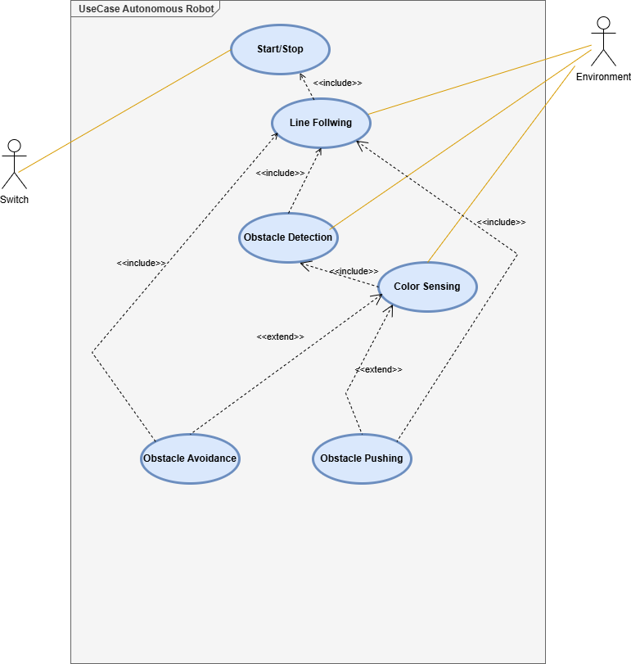
BEHAVIOURAL DIAGRAM:
USE CASE
• Highlights the main interactions between the user and the robot
• Covers use cases like starting the robot, detecting obstacles, and reacting to object color
• Defines the system’s functional boundaries from the user’s perspective
11

Slide 13
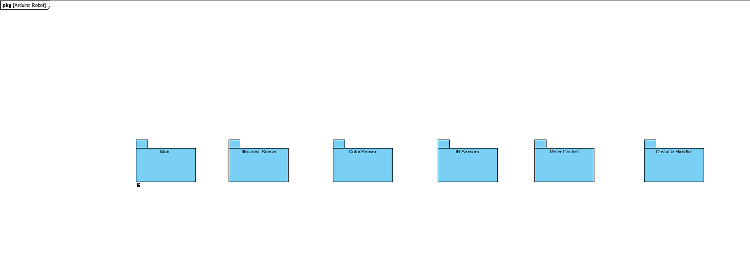
STRUCTURAL DIAGRAM: PACKAGE
• Organizes the system into logical groups or modules
• Separates functionalities like sensing, control logic, and actuation
• Helps manage complexity by structuring related elements together
12

Slide 14
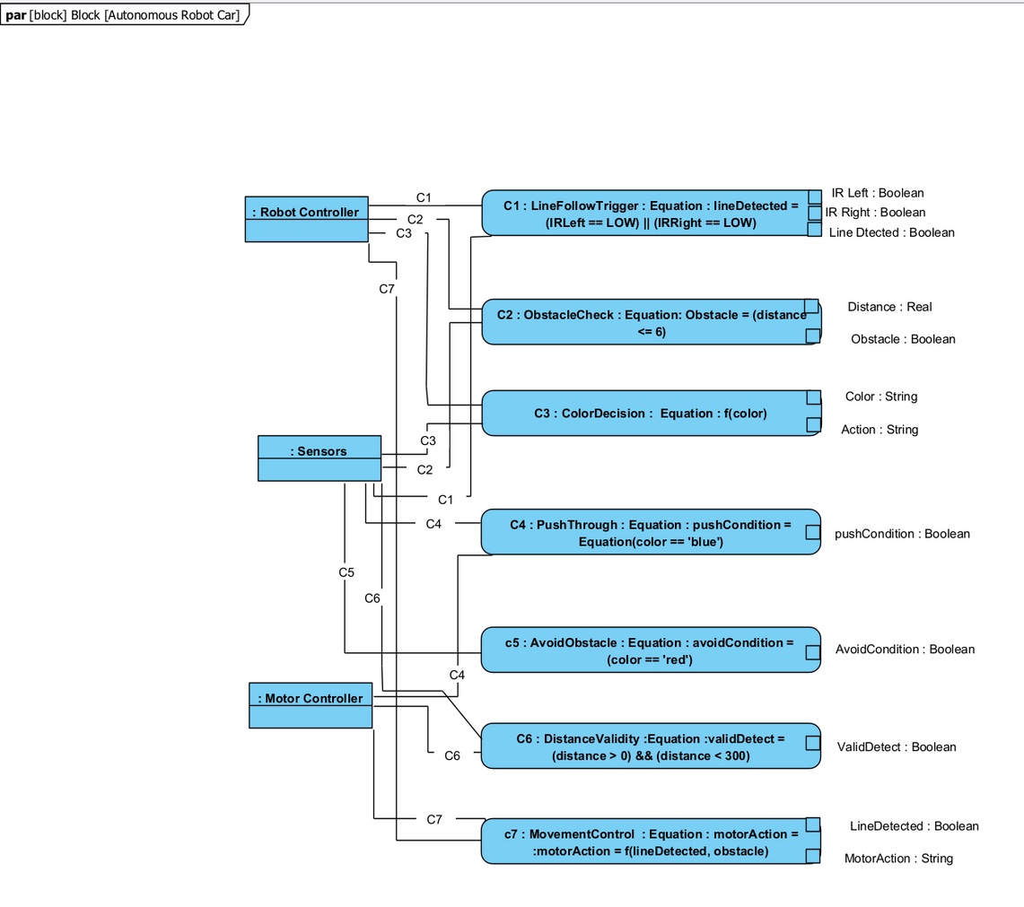
PARAMATRIC DIAGRAM:
• Defines relationships between physical parameters of the system
• Models constraints like speed, distance, and sensor thresholds
• Supports performance analysis and system tuning
13

Slide 15
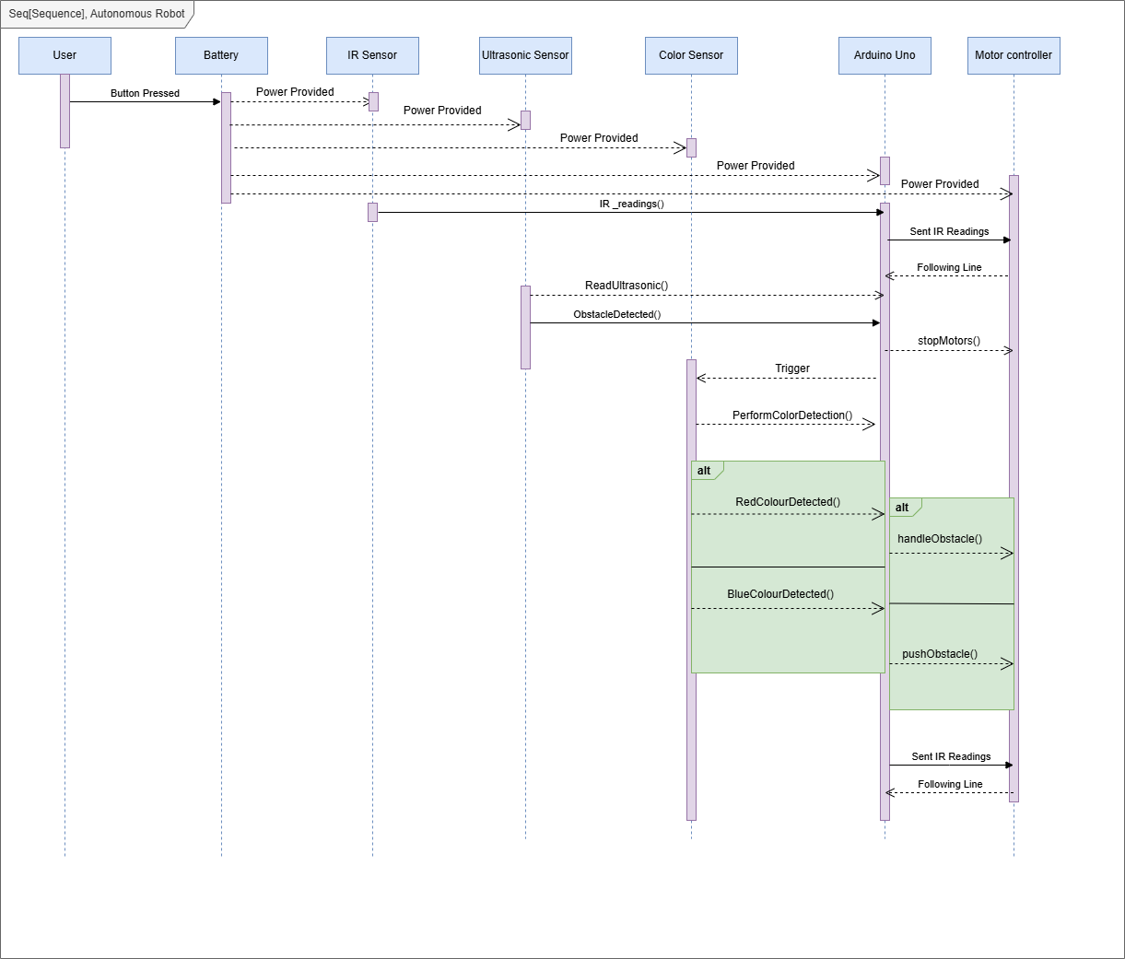
BEHAVIOURAL DIAGRAM: SEQUENCE
• Describes the interaction flow between system components over time
• Shows the sequence of events during line following, obstacle avoidance, and color detection
• Helps visualize timing and message exchange between sensors, controller, and actuators
14

Slide 16
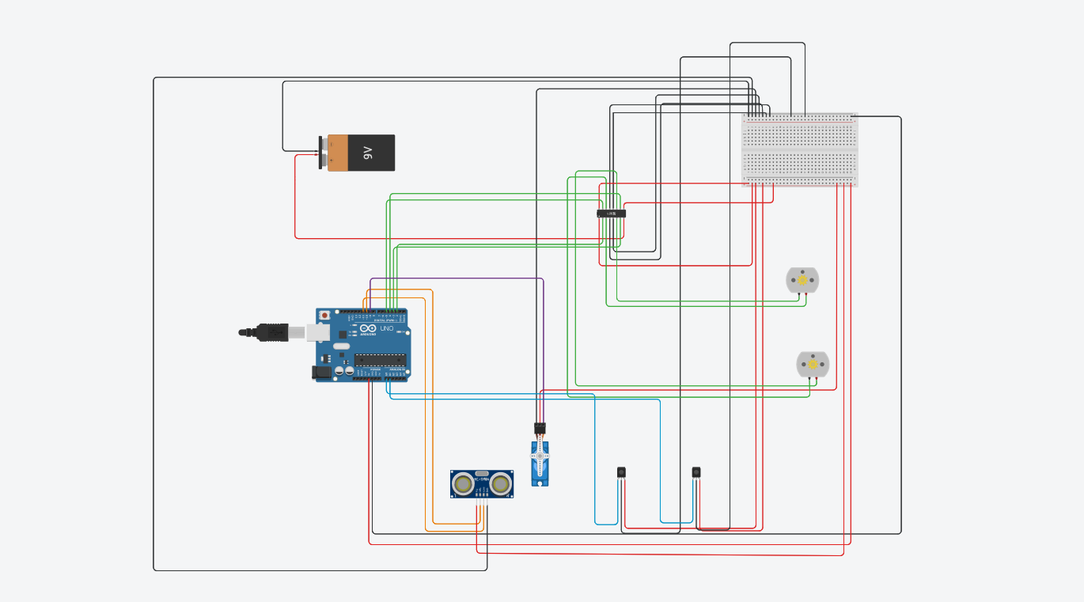
TINKERCAD SIMULATION:
15

Slide 17
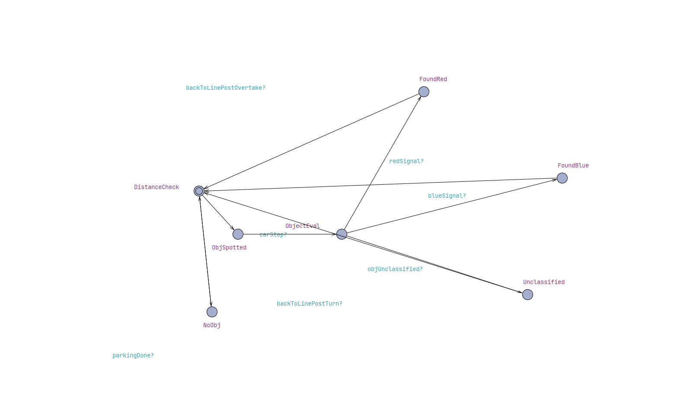
UPPAAL SIMULATION:
• Used to verify the timing and logical behavior of the robot’s states
• Simulates transitions between line following, avoiding, and color handling which follows the State Machine Diagram
16

Slide 18
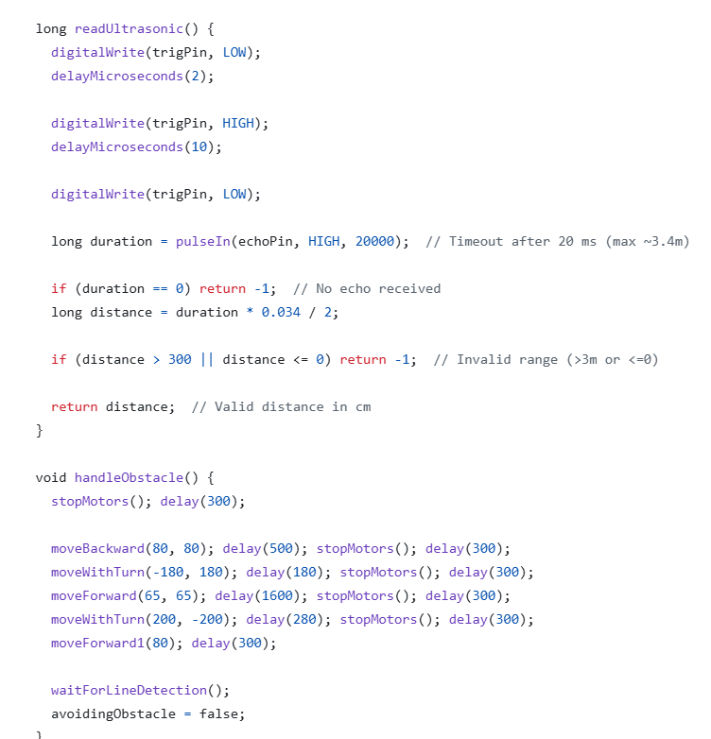
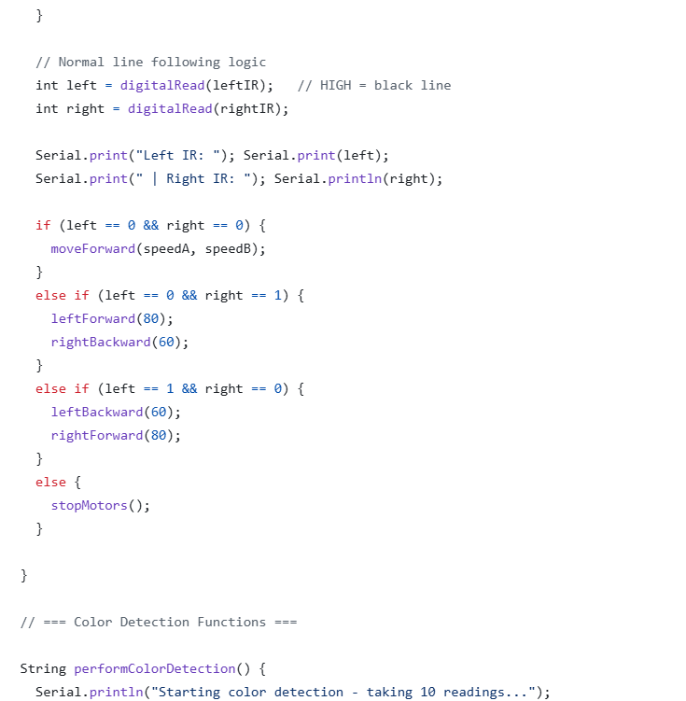
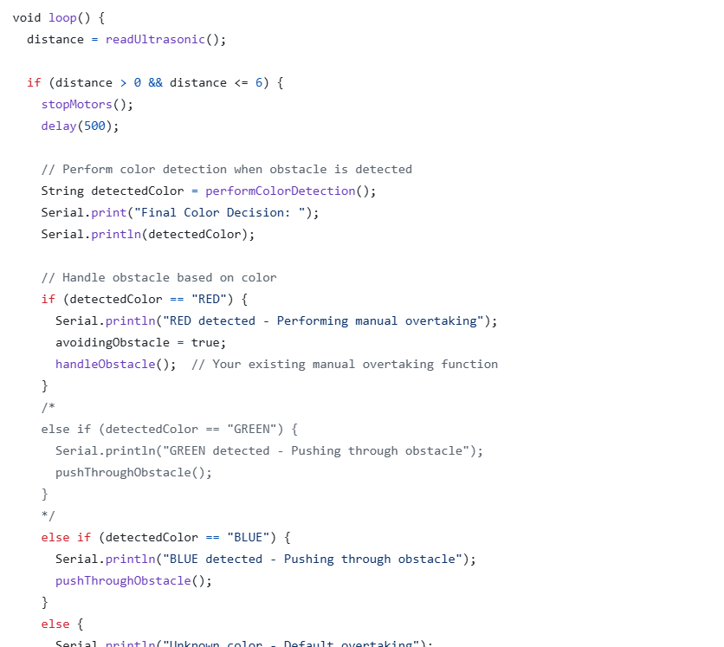
CODE: LOOP, IR AND ULTRASONIC SENSORS
IR Code
Loop
Ultrasonic
17

Slide 19
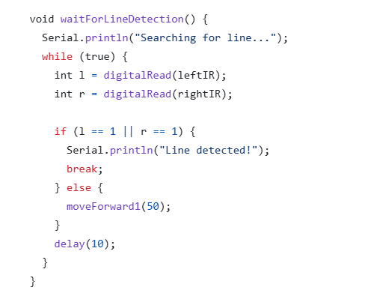
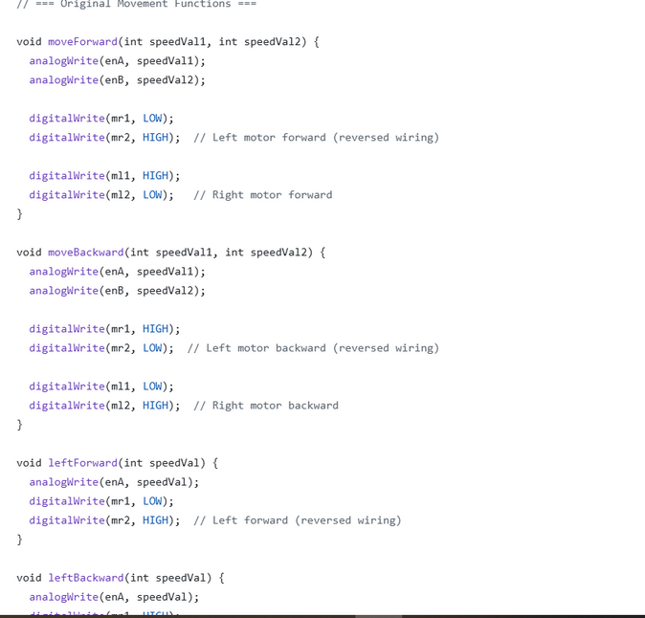
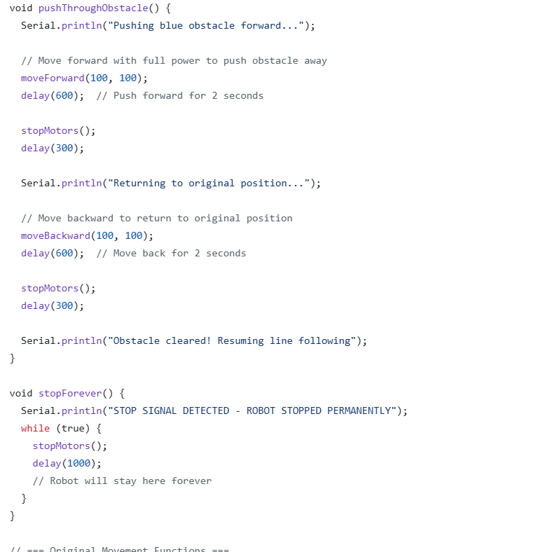
CODE: CONTROLING MOTORS, FINDING LINE AND PUSHING THE OBSTACLE
Pushing Obstacle
Finding line
Motor Control
18

Slide 20
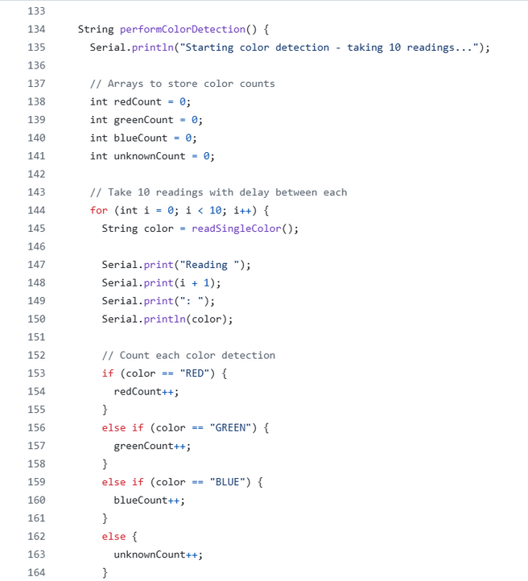
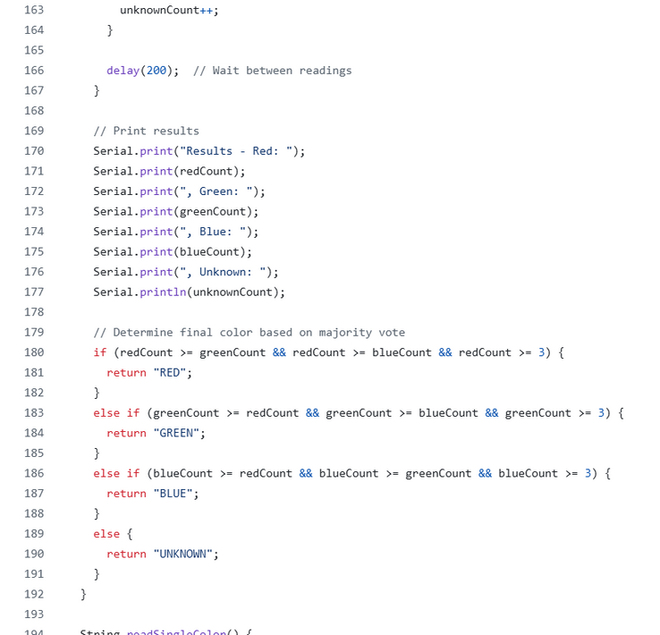
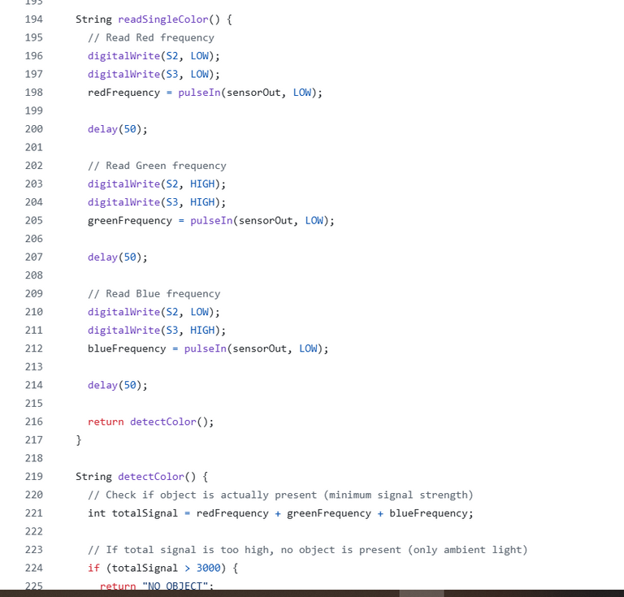
CODE: PERFORMING COLOR DETECTION
19

Slide 21
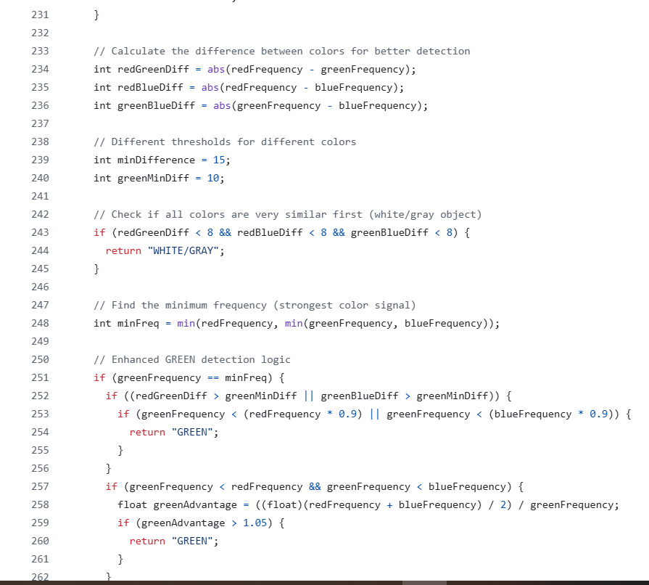
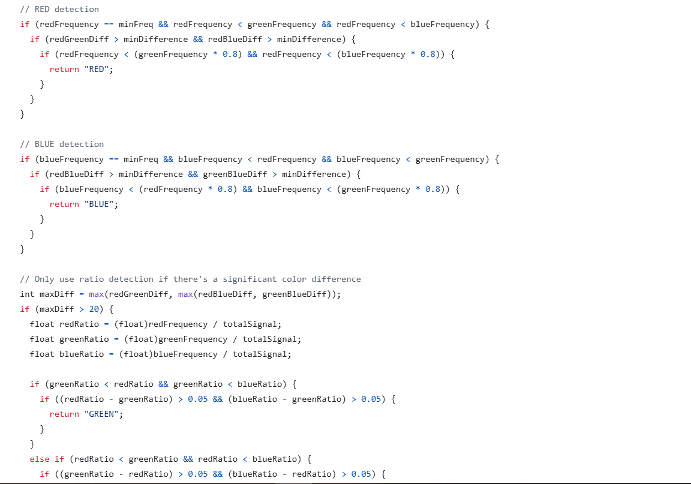
CODE: PERFORMING COLOR DETECTION
20

Slide 22
WHAT WE FACED, FIXED, AND FIGURED OUT
• Simulated the full circuit and logic in Tinkercad, enabling early debugging
• Verified state transitions using UPPAAL, ensuring reliable system behavior
• Faced IR sensor issues—learned sensitivity varies across surfaces
• Used AI to analyze color sensor frequency and identify working thresholds
• Overcame challenges through testing, tuning, and sensor-specific adjustments
21

Slide 23
THANK YOU VERY MUCH!
Refrences:
Github: https://github.com/Md-helaluddin/D4---Prototyping
Tinkercad: https://www.tinkercad.com/things/hqYCjAoHVhd-frantic-gaaris-curcan

